Slide 1
Introduction
EcoLearn platform
Real Time Research Project
Presented By: Mohammed Arquam Khan (211)
Mohammed Waleed Ahmed(220)
Mohammed Anas Siddique(206)
Sandeep (205)
G. Pavan (LE-206)

Slide 2
Problem Statement
Environmental education is often limited to textbooks without real-life connection
Students do not learn about environmental issues in their own local communities
Lack of practical understanding of how daily actions impact the environment
Limited availability of engaging and interactive learning tools
Students struggle to develop eco-friendly habits
Difficulty in seeing the real impact of their choices on the environment
Low interest among youth in environmental protection
Minimal participation in local environmental projects
Traditional teaching methods fail to inspire long-term behavioral change
Lack of active involvement in solving real environmental problems

Slide 3
proposed solution
🌱 Environment Game – Tech Stack Overview
A gamified mobile/web platform designed to teach environmental concepts, games, challenges, and real-world activities.
Focuses on interactive, engaging, and experiential learning instead of traditional rote memorization.

Slide 4
Features
Encourages students to take practical eco-friendly actions such as:
Tree planting
Waste segregation
Energy conservation
Integrates a tracking systemincluding:
Eco-points
Badges
Rewards
To motivate continuous participation.
Designed to create a ripple effect, where:Students influence families

Slide 5
Supports India’s NEP 2020 goals of:
Digital learning ,Experiential learning, Skill-based education
Aligns with Sustainable Development Goals (SDGs):
Goal 13: Climate Action
Goal 15: Life on Land
Bridges the gap between education and real-world action, creating responsible and eco-conscious citizens.
Promotes a culture of green challenges among schools and colleges.

Slide 6
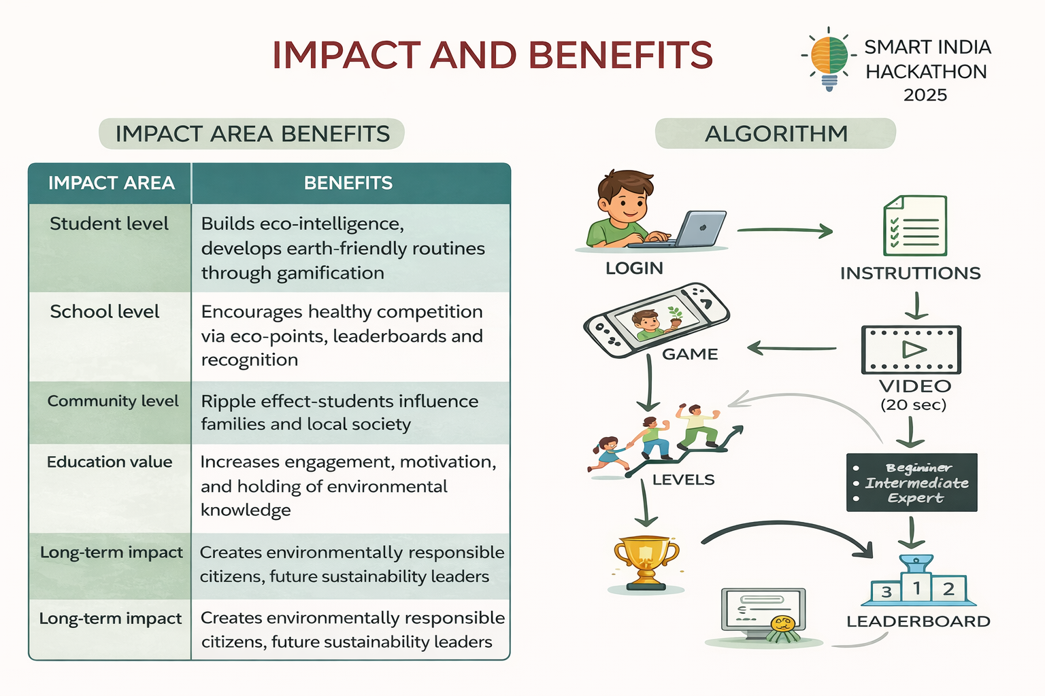

Slide 7
Conclusion
• It encourages students to take real-life eco-friendly actions, not just learn theory.
• Gamification through points, badges, and rewards keeps students motivated and engaged.
• Helps build long-term awareness and responsible habits towards the environment.
• Creates a positive ripple effect by influencing families and communities.
• Supports NEP 2020 goals like digital and experiential learning.
• Aligns with Sustainable Development Goals (SDGs) such as Climate Action and Life on Land.
• Bridges the gap between education and real-world environmental impact.
• Contributes to creating eco-conscious and responsible citizens for the future.

Slide 8
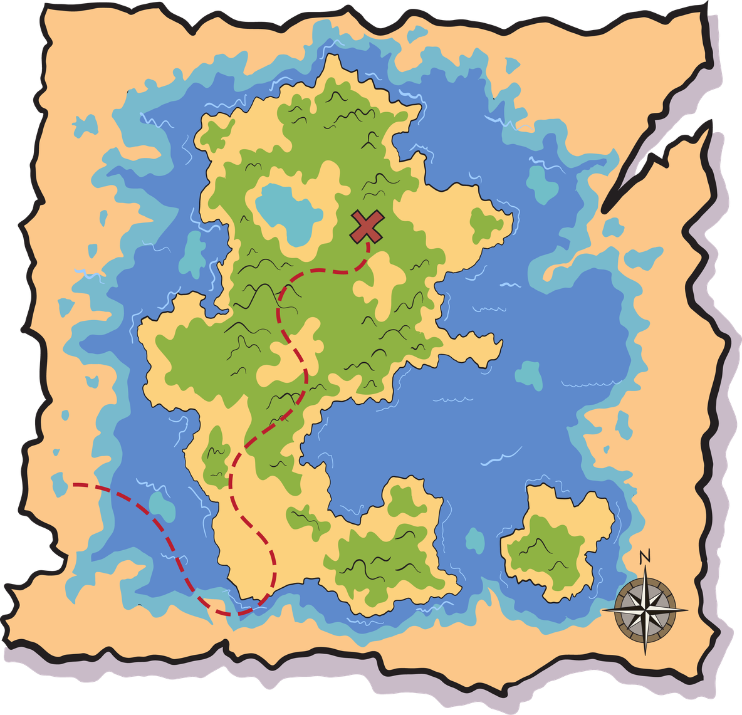
Thank
You

